Slide 1
Video Segmentation: Bridging the Semantic Gap For Television Content
Geetu Ambwani
Notes:
This set of slides is a summary presentation (given in various public fora) of my research work in video segmentation at Streamsage/Comcast

Slide 2
Outline of talk
Multimedia search, browsing, and retrieval: how is it different?
The temporal aspect: searching and browsing feel different
The multimodal aspect: information delivered to the user in many forms
Deep indexing of commercial video
Segmentation
Categorization and topic analysis
A wide range of content types
Some pilot projects
News segmentation and categorization
Narrative thread detection in dramatic programming
Navigating through sports
Evaluation
Is any of this is effective, useful, or compelling?
Conclusions and future work

Slide 3
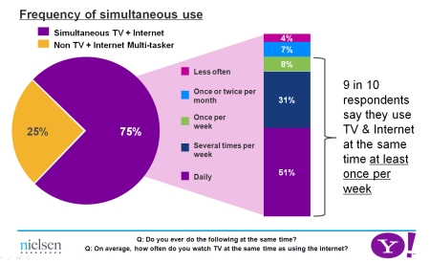
Central Motivation
TV/Video is a very content rich medium – places, faces, topics …
Watching television today is a very linear experience (ugly grid)
Unlike the browsing the WWW (hyperlink to hyperlink)
Three out of four (75.6%) respondents who watch television while online visit websites directly related to the TV program they watch. (Burst Media Survey)
Notes:
TV as we know is a very rich medium – lots going on in a video. But navigating tv is still a very linear experience. We are used to browsing the web these days where we can jump from hyperlink to hyperlink but the way we consume video is still like we did in the 80s. We go from channel to channel , with not too much information available in terms of what we are watching. Clearly there must be a better way
There are lots of research and surveys that show consumers these days visit websites related to the program they are watching currently in search of information.
How can we support a more intuitive and fun way of navigating all the thousands of hours of video content that we provide ?

Slide 4
Multimedia Search & Browse
Semantic Gap – well known problem in multimedia research
Lots of work on searching and classifying video from lower level audio visual features. (TRECVID)
Text Query matches
Similar Shots
Face Detection
Scene Detection
Our Approach:
TV Queries not that low-level
Can we break video into individual semantic units i.e. clips that are semantically coherent ?
Notes:
Now video navigation and browsing is not a new problem – there's been lots of prior work particularly at trecvid but because of the semantic gap that exists, right now we are still only able to do low level markups like shots , and text query matches. But this sort of thing is not good enough for tv search and browse.
When it comes to television, we need a better understanding of the video so we can split it into individual semantic units that can stand on their own. Our hope is that if we can break programs into base units, then these can be rearranged and presented to the consumer in a fashion that’s usable.

Slide 5
Video Search & Browse
When people look for a term or a concept, they are looking for context as well. One has to find the relevant portion of the video
Video is made up of “Segments of Interest”
Job Plan in Obama Speech
Just figuring out the first mention of the word “jobs” is not good enough
Video is really hard to browse through !
Find the portion of the video that addresses his jobs plan.
Long form video is inherently structured.
Breaking it into its constituent parts is not easy.
Notes:
What do I mean by a base unit for a video ?
If I am watching a speech by Obama and I only care about what he has to say about jobs, simply pointing me to the first place where the word “job” shows up is not helpful. Ideally you want to find the portion of the speech that is relevant to jobs – so we want to find the section of the video where he talks bout unemployment, jobs, his plan etc.
We want to emphasize pulling the semantics of text, audio & video to come up with a clip.

Slide 6
Video Segmentation
What is segmentation?
Single, exhaustive partitioning of a video into a set of continuous segments?
Or can segments…
Overlap?
Be discontinuous?
Leave out some of the video?
Have fuzzy boundaries, perhaps determined by voting/crowdsourcing?
Be nested in some hierarchical fashion?
Be dependent on user and context specific factors, like search history?
What constitutes useful segmentation varies by content type
Sports: some sports have very natural segments (plays); others don’t
News shows: typically very clearly segmented
Dramatic content: much more nebulous what makes for a good segment
Can we really guess at what the user wants?
Ultimately, do we need to support a more personalized navigation experience ?
Perhaps crowdsource?
The YouTubization of premium content
Notes:
Now conceptually of course, segmentation is not trivial.
There are lots of open questions
Does it depend on the specific domain
Is there a hierarchical structure for these clips.
Are there constraints on how we create them – overlap , non overlap, soft, hard boundaries
And ultimately, they might actually be fairly user specific. In the end what you are trying to do is divide video into base units that are useful when you rearrange them somehow. Now the base unit might best be user specific. How I will end up dividing a sitcom is probably different from how my friend might do it just because we lay emphasis on different thing

Slide 7
Video Segmentation, if Solved …
With Context Specificity …
Football by plays
News Shows by Topic
Movies by important Scenes
Food shows by Recipe Steps
Could Support A Host of Applications …
Personalized Channels (Organized by topics you care about)
Intelligent DVR Navigation/Chaptering
Second Screen Experience (IPad, Mobile …)
TV as Social Experience (Sharing clips, Recommendations)
Targeted Advertising
Notes:
Now if we were able to agree on semantic units for content types then what kind of applications could we support
Football by plays; news by topics, food by recipes, and so forth …

Slide 8
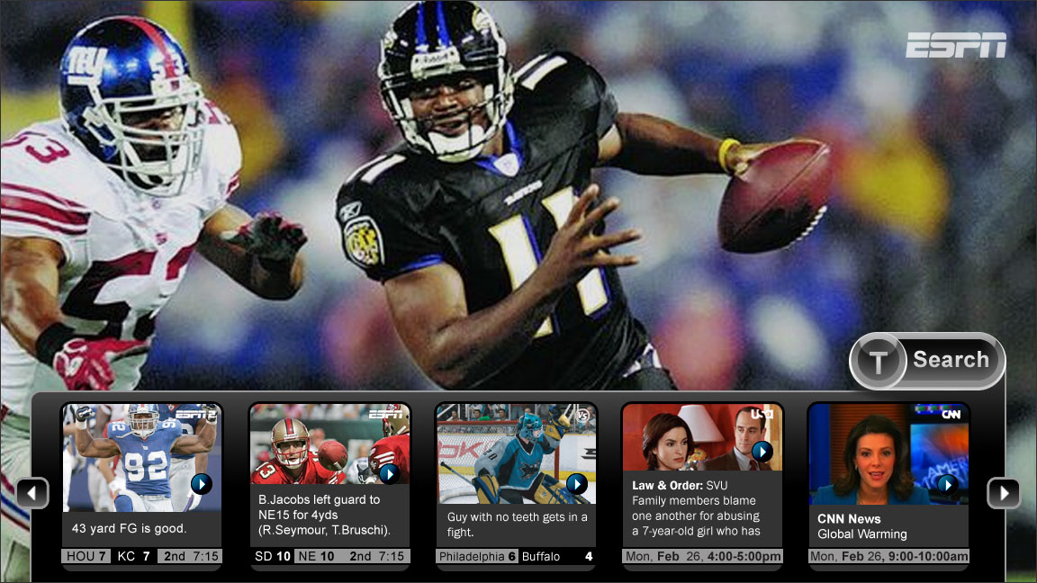
Browsing in the moment …
Notes:
You click the magic button and your tv can tell you whats going on in the other channels down to the moment

Slide 9
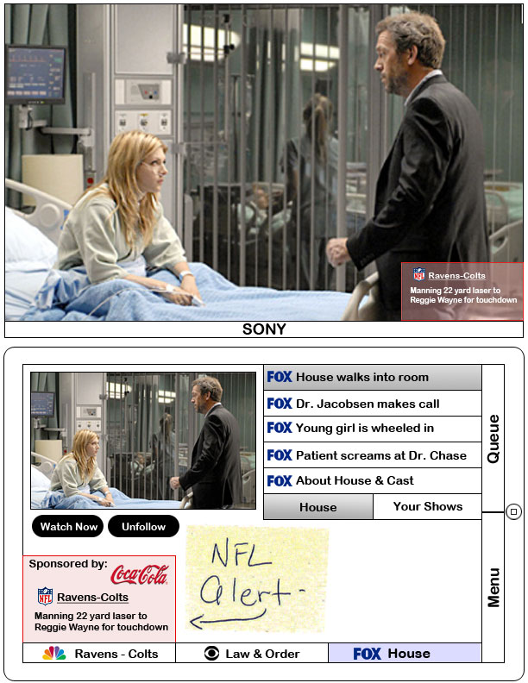
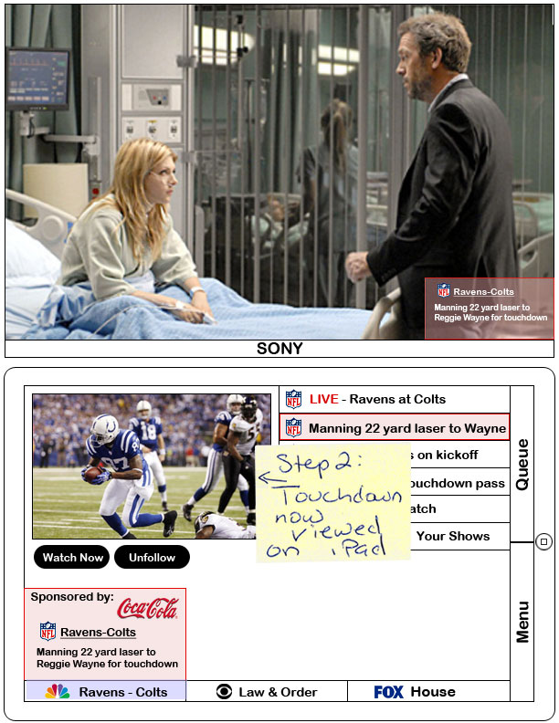
Consume media differently …
Alert for NFL game while watching House (top view TV, bottom view iPad)
Notes:
And your tv can automatically alert you when something important is happening on another channel.

Slide 10
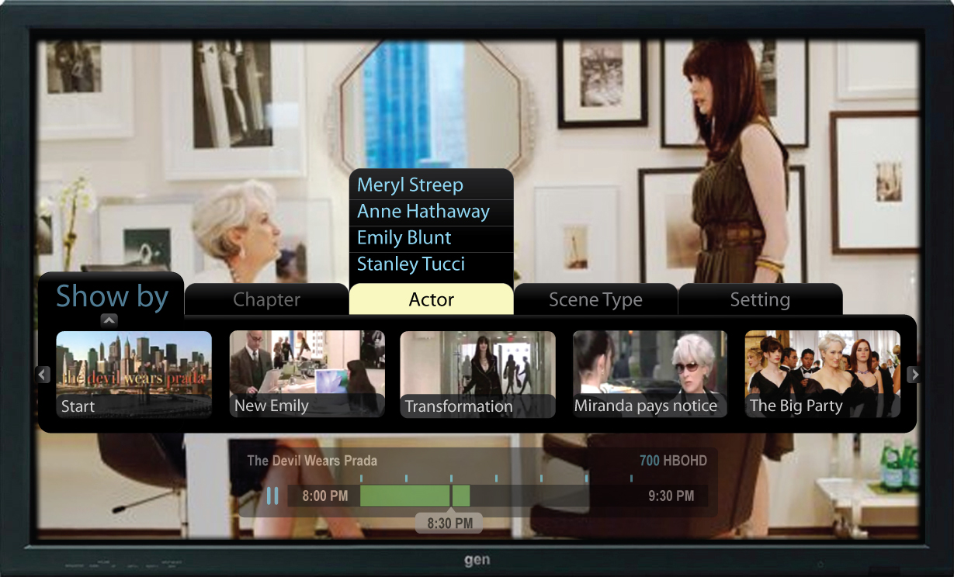
Navigate Differently …
Notes:
You could choose to skip backwards and forwards but now intelligently , by actor, by a particular type of scene.

Slide 11
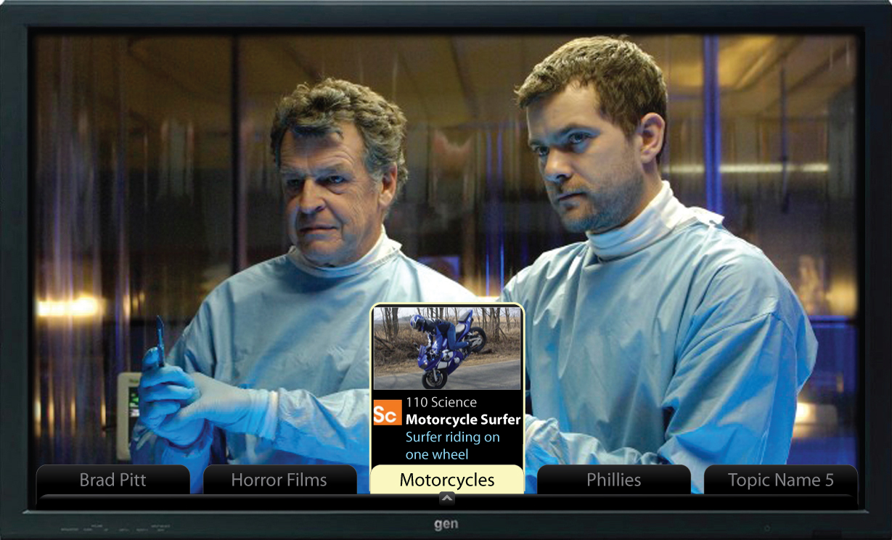
Follow the things you care about …
Notes:
And finally, you can set this all up so you follow the things you care about.
U can create your own private channel.
Imagine a “Geetu channel” that would comprise clips curated by me.
As you can see, there are a whole host of applications that get enabled when we can split video in different ways and rearrange them for consumption.
Now most of my talk I will be concentrating on the segmentation aspect where I will dive a little deeper in the details.
But the arrangement of these video clips and what you do with them is research topic in its own right. I will address these briefly when I discuss our pilot applications.
But now lets talk about our segmentation approach

Slide 12
Multimodal Segmentation Framework

Slide 13
Towards a Multi-Modal Approach
Video for TV is very content rich
Text , Audio, Video, External Metadata
Our Goal:
Segmentation for multiple content types:
Build flexible framework that can learn appropriate models for news, food, travel, entertainment, and other content types
Pipeline for Features
Machine Learning to predict where the segment boundary occurs
However, we began with a news segmentation system, because:
Good metadata is available (closed captions and related stories from the web)
Useful segments (stories) are clearly defined
Notes:
Our goal as I said is to make use of all the information we have available to us both inside the video and outside.
And we want to build a framework that can learn the appropriate segmentation for the given content type.
So we first build a pipeline of features that we think are useful. And we are constantly adding to these…
“However, we started by developing a system that could automatically produce segments in news, because:…”

Slide 14
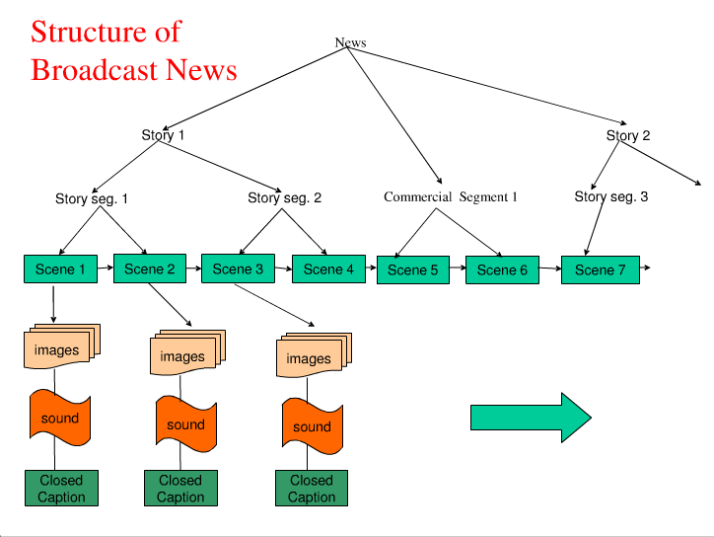

Slide 15
Textual Features

Slide 16
Textual Features
Closed Caption Boundaries
Manually added to the closed captions by humans
“>>” when the speaker changes
“>>>” when the topic changes
Pretty accurate but not always complete
Person Name Detection
Currently simple name matching with dictionary of entity names
Named Entity Extraction is a hard problem ☺
Dynamic nature of names means that we need constant updates.
Luckily we don’t need to solve it for segmentation
We only care if we see a new person name in a sentence or if we saw that name before.
Features: personExists, personContinue.
Notes:
Lets talk bout some of the textual features in our pipeline
Video as we know comes with closed captions. We also run SR on it to get transcripts.
Sometimes the closed captions actually have topic shifts marked in them – typically for news programs. But not always.
And we also markup person names in the text. We would also like to use face recognition for this but for now we are just using text. The general idea is that if you see the same person name appearing on both sides of a sentence then the possibility of the sentence being a boundary should be downweighted.

Slide 17
Textual Features
Cue Phrases
Words and phrases which serve primarily to indicate document structure or flow, rather than to impart semantic information about the current topic (Good Morning, well, now, When we come back, etc)
Bootstrapping Approach
Check area around commercial boundaries, >>> in transcripts.
Look for phrases in preceding 2 & following 2 sentences, compute average probability.
Salient Tags
Identify rare terms with high frequency. See which terms occur across sentences (with strong links).
Notes:
We also look for cue phrases – certain anchors have catch phrases that they love to use.
We also try to identify salient phrases – the idea again being that the chances of you seeing the same salient phrase on the right and left hand side of the boundary is low.
if a word occurs in 2 sentences, then theres a link. look for places where the thickness of links is very thin. then those are breaks. the topics are the words with lots of links. link between 2 sentences if they have same words. then u get a weaker link with a high cow values. these are the topic words associated with a segment.

Slide 18
Contextually Mediated Semantic Similarity Graphs for Topic Segmentation
Joint work with Tony Davis
ACL Workshop 2010
Notes:
And now we have one more really important textual feature that we call graphy. It’s a graph Based Algorithm for Topical Segmentation which has state of the art performance. We presented this at ACL last year and I will go into this in a little more detail

Slide 19
Related Work on Segmentation
Previous work has used several approaches
Discourse features
Some signal a topic shift; others a continuation
Highly domain-specific
Similarity measures between adjacent blocks of text
Typical document similarity measures used, as in TextTiling (Hearst, 1994) or Choi’s algorithm (Choi, 2000)
Choi measures lexical similarity among neighboring sentences
Posit boundaries at points where similarity is low
Lexical chains: repeated occurrences of a term (or of closely related terms)
Again, posit boundaries where cohesion is low (few lexical chains cross the boundary (e.g., Galley, et al., 2003)
Notes:
There has been prior work done on text segmentation, mostly concentrating on sentence similarity between neighboring sentences and identifying areas of low lexical cohesion
Choi works by building a matrix of sentence similarities while other techniques have used lexical chains.

Slide 20
Motivations behind our approach
Model both the influence of a term beyond the sentence it occurs in and semantic relatedness among terms
The range of a term’s influence extends beyond the sentence it occurs in, but how far? (relevance intervals)
Semantic relatedness among terms (contextually mediated graphs)
Apply this model to topic-based segmentation
Notes:
We incorporate these insights into a graph which we then try to segment into topically coherent sections.
Our approach is similar to last 2 approaches but what we want to do is explicitly model the range of a terms influence. We represent this in a graph. And then we look for subgraphs where discourse coherence is high.
Our hope is that modeling these phenomenon will provide a good way to segment text coz segment boundaries will occur where the coherence is low.

Slide 21
Relevance Intervals

Slide 22
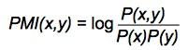
Relevance Intervals (RIs)
Each RI is a contiguous segment of audio/video deemed relevant to a term
Developed originally to improve audio/video search and retrieval
RI calculation relies on a pointwise mutual information (PMI) model of term co-occurrence (built from 7 years of New York Times text, 325M words)
Previously evaluated on radio news broadcasts, and currently deployed in Comcast video search
Anthony Davis, Phil Rennert, Robert Rubinoff, Tim Sibley, and Evelyne Tzoukermann. 2004. Retrieving what's relevant in audio and video: statistics and linguistics in combination. Proceedings of RIAO 2004, 860-873.
Notes:
RI is a way of modeling scope of a terms influence beyond the sentence it occurs in.
We use a corpus of nytimes – basically pmi values nxn matric of pmi values.
We use pointwise mutual info between a term and terms near it to determine whether additional sentences should be included in the
We build ri for a term based on pmi values between that term and other terms occurring in neighboring sentences. If the following sentence has high pmi terms, then we extend that interval.

Slide 23
Relevance Intervals (RIs)
Each RI is a contiguous segment of audio/video deemed relevant to a term
RIs are calculated for all content words (after lemmatization) and common multi-word expressions
An RI for a term is built outwards, forward and backward from a sentence containing that term, based on:
PMI values between pairs of terms across sentences; high PMI values suggest semantic similarity between terms
Discourse markers which extend or end an RI
Synonym-based query expansion, using information from WordNet
Anaphor resolution – roughly based on Kennedy and Boguraev (1996)
Nearby RIs for the same term are merged
Large-scale vocabulary shifts (as determined by a modified version of Choi (2000) to indicate boundaries) *****
Notes:
There are various linguistic and statistical features that are used in calculating RIs – u can talk to me offline for more details.
In addition, we limit the expansion of relevance intervals by noting large scale vocab shifts in document using a modified version of chois algo.

Slide 24
Relevance Intervals: an Example
Index term: squatter
among the sentences containing this term are these two, near each other:
Paul Bew is professor of Irish politics at Queens University in Belfast.
In South Africa the government is struggling to contain a growing demand for land from its black citizens.
Authorities have vowed to crack down and arrest squatters illegally occupying land near Johannesburg.
In a most serious incident today more than 10,000 black South Africans have seized government and privately-owned property.
Hundreds were arrested earlier this week and the government hopes to move the rest out in the next two days.
NPR’s Kenneth Walker has a report.
Thousands of squatters in a suburb outside Johannesburg cheer loudly as their leaders deliver angry speeches against whites and landlessness in South Africa.
“Must give us a place…”
We build an RI for squatter around each of these sentences…
Notes:
Each of these occurrences is seed for a ri. And we expand the ri according to terms in adjacent sentences.

Slide 25
Relevance Intervals: an Example
Index term: squatter
among the sentences containing this term are these two, near each other:
Paul Bew is professor of Irish politics at Queens University in Belfast.
[Stop RI Expansion]
In South Africa the government is struggling to contain a growing demand for land from its black citizens. [PMI-expand]
Authorities have vowed to crack down and arrest squatters illegally occupying land near Johannesburg.
In a most serious incident today more than 10,000 black South Africans have seized government and privately-owned property. [PMI-expand]
Hundreds were arrested earlier this week and the government hopes to move the rest out in the next two days.
NPR’s Kenneth Walker has a report.
Thousands of squatters in a suburb outside Johannesburg cheer loudly as their leaders deliver angry speeches against whites and landlessness in South Africa.
[Stop RI Expansion]
“Must give us a place…”
We build an RI for squatter around each of these sentences…
Notes:
Expansion stops when there arent enough related terms.

Slide 26
Relevance Intervals: an Example
Index term: squatter
among the sentences containing this term are these two, near each other:
Paul Bew is professor of Irish politics at Queens University in Belfast.
[Stop RI Expansion]
In South Africa the government is struggling to contain a growing demand for land from its black citizens. [PMI-expand]
Authorities have vowed to crack down and arrest squatters illegally occupying land near Johannesburg.
In a most serious incident today more than 10,000 black South Africans have seized government and privately-owned property. [PMI-expand]
Hundreds were arrested earlier this week and the government hopes to move the rest out in the next two days. [merge nearby intervals]
NPR’s Kenneth Walker has a report. [merge nearby intervals]
Thousands of squatters in a suburb outside Johannesburg cheer loudly as their leaders deliver angry speeches against whites and landlessness in South Africa.
[Stop RI Expansion]
“Must give us a place…”
The two intervals for squatter are merged, because they are so close
Notes:
Since the 2 intervals are close together, they are ultimately merged into one itnerval for squatter.

Slide 27
Documents → Graphs → Segmentation
Notes:
Once we have ris we can start constructing our graphs.

Slide 28
(S_1) Yesterday, I took my dog to the park.
(S_2) While there, I took him off the leash to get some exercise.
(S_3) After 2 minutes, Spot began chasing a squirrel.
______________________(Topic Shift)______________________
(S_4) Then, I needed to go grocery shopping.
(S_5) So I went later that day to the local store.
(S_6) Unfortunately, they were out of cashews.
Notes:
Heres a toy discourse to illustrate how the graphs are constructed.

Slide 29
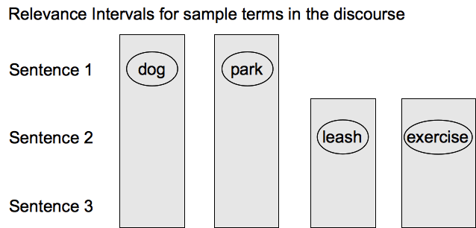
RIs → Nodes
Construct a graph in which each node represents a term and a sentence, iff the sentence is contained in an RI for that term
Notes:
We being by creating RIs for the contentful words. So for ex: RI for dog will go from sentence 1 -3 and so forth

Slide 30
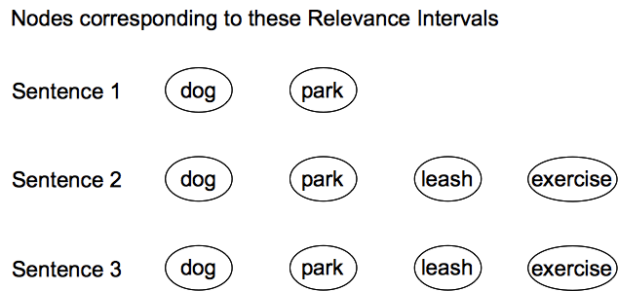
RIs → Nodes
Construct a graph in which each node represents a term and a sentence, iff the sentence is contained in an RI for that term
Notes:
Now we transform each ri into a set of nodes, one for each sentence that the ris covers. So u can see that theres a node for dog in sentence 1, 2 & 3.
Assume that the ri for dog which occurs in 1st sentence, extends from sentence 1 to sentence 3, then we create nodes for dog in each of these sentences.

Slide 31
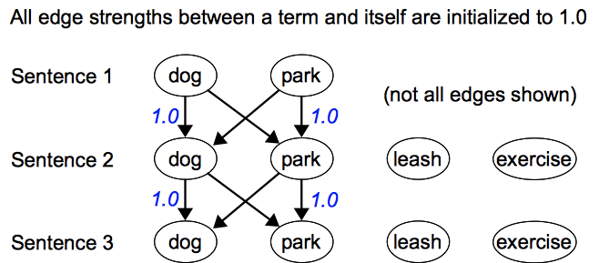
Connecting the Nodes …

Slide 32
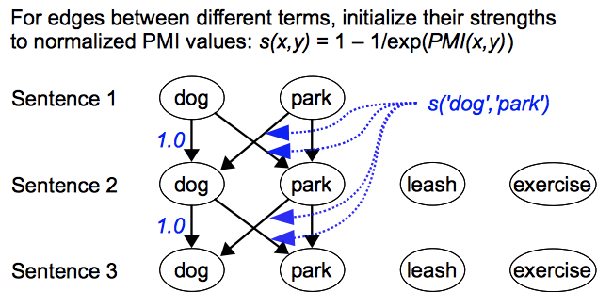
Calculating connection strengths for edges
Notes:
We start out with connection strength between 2 different terms, say dog and park as their normalized pmi value. (called s(x,y))

Slide 33
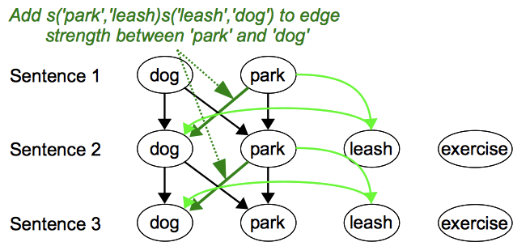
Calculating connection strengths for edges
Notes:
We want to amplify the connection strength between dog and park coz we have the word leash in context.

Slide 34
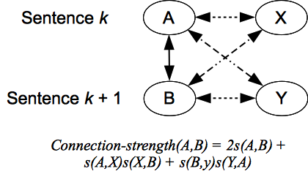
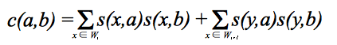
Connection strength formula
and in general, for terms a and b in sentences i and i + 1 respectively:
Notes:
So in general, we amplify the connection strength of a & b with the product of contextual term x with a & x with b.
we use this formula. We add the products of strengths with a & b.
So formula generalizes to that.

Slide 35
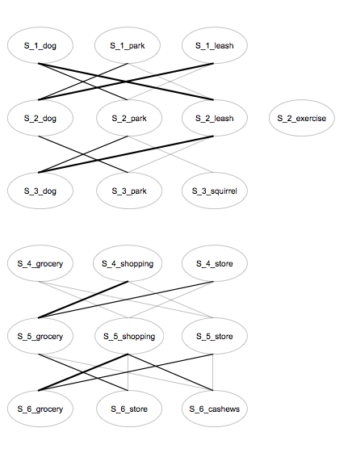
Filtering edges in the graph
We filter out edges with a connection strength below a set threshold (we’ve tried a couple and usually use 0.5)
Notes:
Result is a graph with edges connecting term nodes in one sentece with term nodes in the following sentences. But many of theosee edges have low connection strengths. So we filter out such edges.
so in our toy example u would end up with 2 subgraphs, one for the first 3 sentences and other for the last 3. each subgraph correspdong to a topically coherent segment.
So we can see these 2 regions fall out, once we filter out edges of weak connection strength.

Slide 36
Graph Representation of Document
(1st 8 minutes of an episode of Bizarre Foods)
Notes:
This is a graph after filtering low weight edges out – u can see u end up with some very dense areas.
Make it clear that this is post filtering.
Lets look at a real example. 1st 8 minutes of an episodes of Bizarre Foods.
make sure to explain that vertical dimension represents time (or sentence number, and the horizontal dimension does too, in a way; the separate pieces of the graph arranged horizontally left to right are just continuations, where there were no strong connections with the preceding piece.

Slide 37
Segmentation from graphs
General idea: look for places in the graph where connections are sparse or weak
Typically, this will be where relatively few Ris cross a boundary
Edges with low connection strengths are unlikely to bear on topical coherence, so it’s best to remove them from the graph
“Normalized novelty”: on the two sides of a potential boundary, the number of nodes labeled with the same terms, normalized by the total number of terms
Notes:
Graph edges getting sparse near topic boundaries.

Slide 38
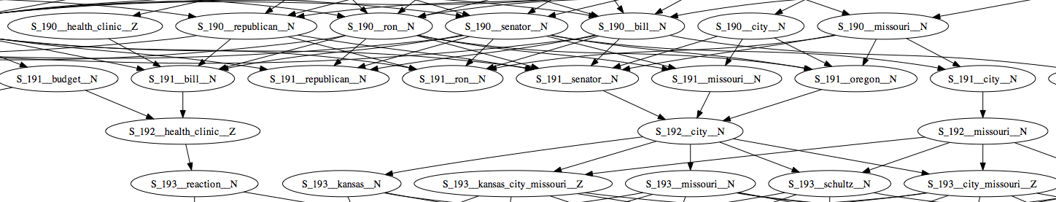
Graph representation of documents
Example snippet and graph from t.v. news broadcast
S_190 We’ve got to get this addressed and hold down health care costs.
S_191 Senator ron wyden, the optimist from oregon, we appreciate your time tonight.
S_192 Thank you.
S_193 Coming up, the final day of free health clinic in kansas city, missouri.
Notes:
U will notice that there are very few terms that occur on both sides of the potential boundary at sentence 192
Throw this out !!

Slide 39
Visual Features

Slide 40
Visual Features
OCR
Logo Detection
Key Frames
Low Level Features
Color Histograms
Face Detection/tracking …

Slide 41
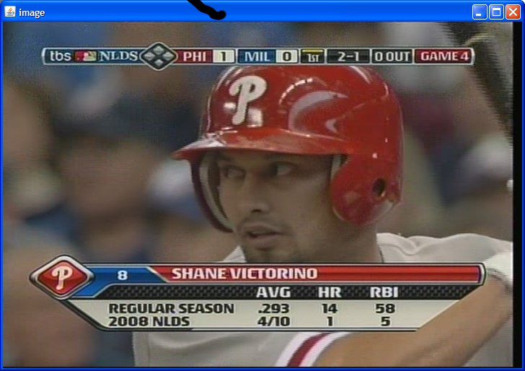
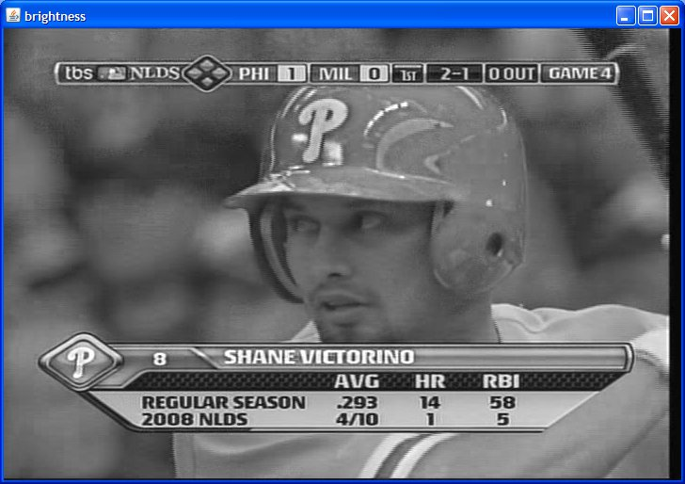
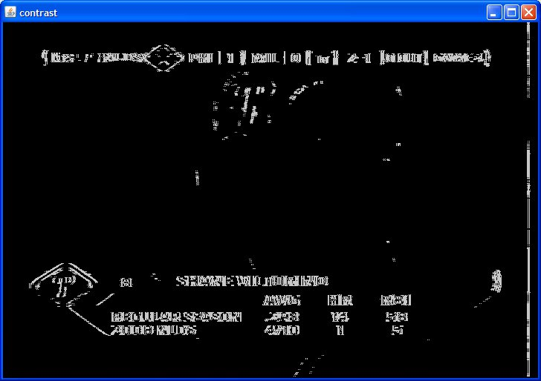
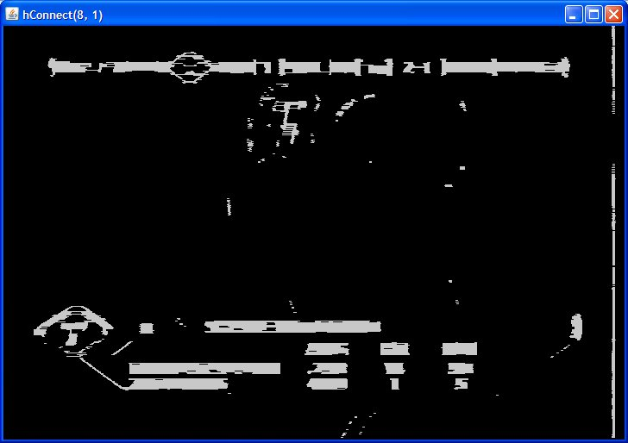
Text Block Detection Steps 1 - 4

Slide 42
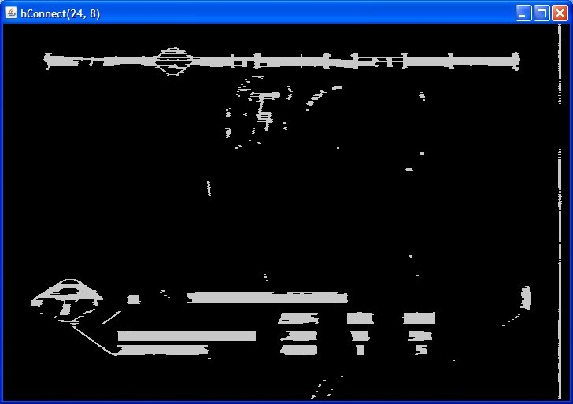
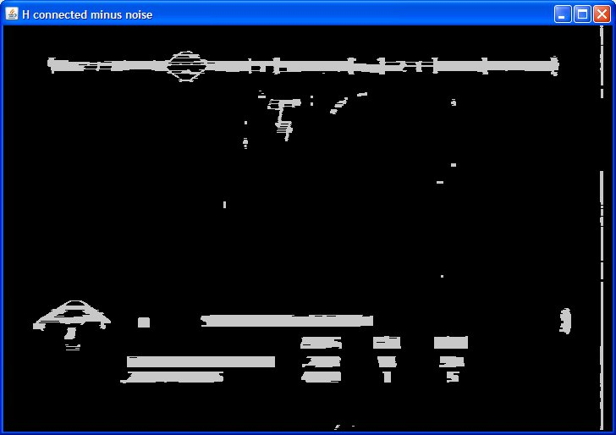
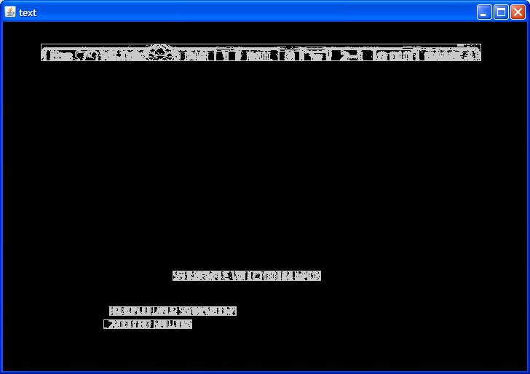
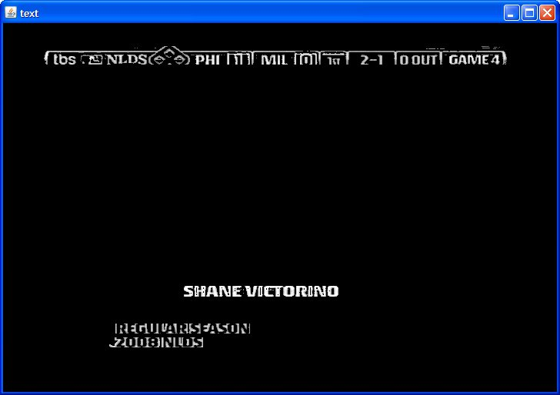
Text Block Detection
Notes:
We essentially use the brightness and contrast of the images to find text like regions. There are some thresholding and filtering to find the connected components.

Slide 43
Video OCR
TextBlock Identification
Image Preprocessing
Averaging noise out over frames
OCR
Open Source Tesseract OCR
Need more error correction – string similarity approaches
Feature for Classification
OCR Continue – For a given sentence, what is the similarity of OCR to previously recognized OCR (High likelihood of being in same segment)
OCR Change – If previous sentence had no OCR and new OCR string appears on screen (High likelihood of new segment)
Notes:
Once we have identified text regions, we pass on the binarzed image through the ocr process.
Its stll very error prone and requires a ton of pre & post processing. But its one of our most useful features when present

Slide 44
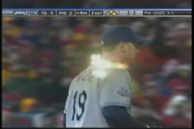
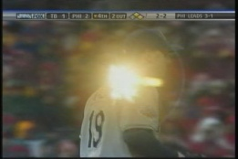
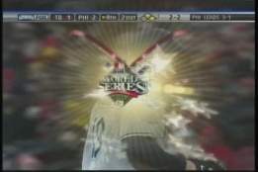
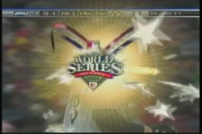
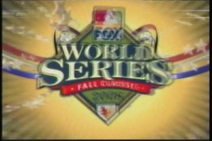
Low Level Visual Features
Standard Visual Processing Pipeline
Black frame detection
Video frame entropy
Pairwise Joint Entropy for the red, green, blue, hue, saturation and value feature
Pairwise Kullback–Leibler (KL) Divergence
Cut Rate Analysis
Histogram Ratios
Logo Detection
Identify parts of image that appear again and again.

Slide 45
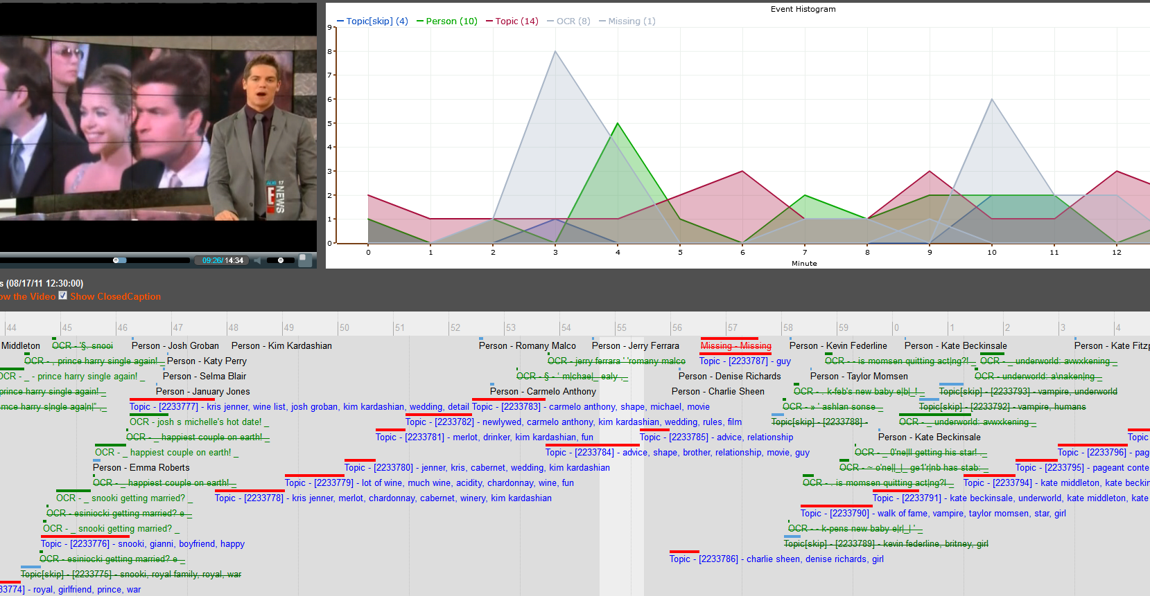
Timeline Screenshots

Slide 46
Segmentation
Features
Text, Video, Audio, Human Annotations, etc
Unbalanced Dataset
Two Approaches
Classification – Support Vector Machines
Sequence Labeling – Conditional Random Fields
Results
High Precision, Low Recall – CRFs
Low Precision, High Recall – SVMs
Different for different news genres (we learn different feature weights)
Features matter most !!!
Notes:
So there are 2 ways of approaching the segmentation.
See it as a classification problem. (predicting whether a sentence is a boundary or non boundary at each instance independently)
See it as a sequence labeling problem (we assume that the sentence label has dependencies on the neighboring labels)
We have tried both and get comparable results.
The more interesting thing is to see how we automatically identify the features that are important for the specific genre.
But more on results later.
Lets talk through some of our applications now.

Slide 47
News Segmentation & Categorization
Notes:
1st pilot

Slide 48
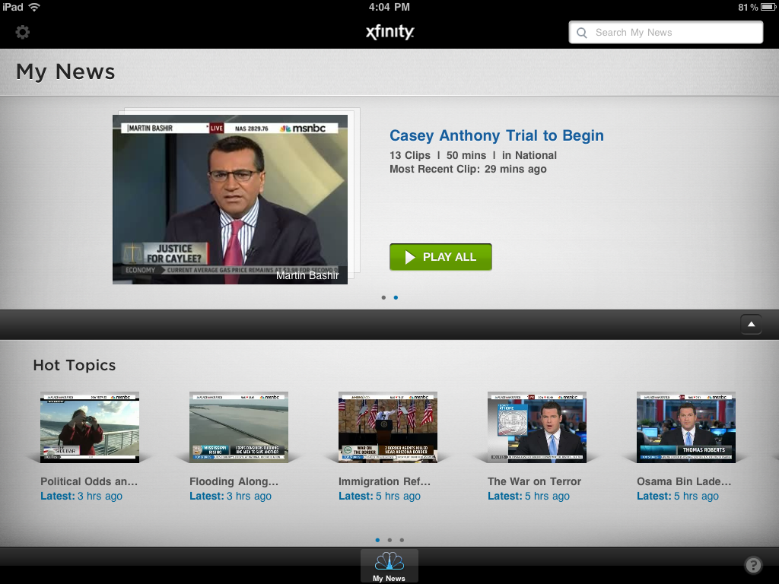
Ipad App
Notes:
One of our first projects and the most advanced stage. An Ipad app for news.

Slide 49
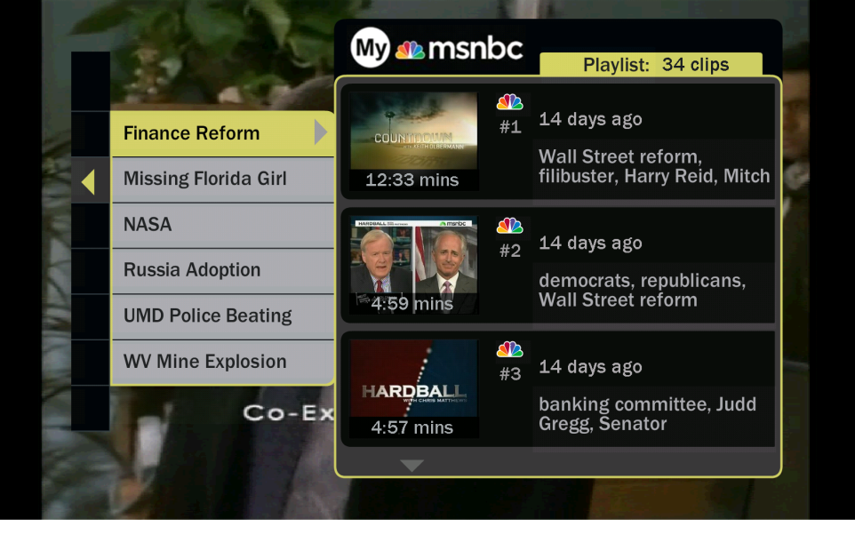
MyNews
News - Highly dynamic domain
Constant ebb and flow in people & stories.
Cable News Program structure – teasers, anchor chatter, many stories repeated, but with modifications and updates
Problems in pinpointing boundaries of semantically coherent clip
High inter annotator disagreement but less so than for dramatic content.
Notes:
Real world system that use segmentation from earlier. We ingest around 10 news channels a day.
You can see the clips are classified by topic. Arranged in a menu so users can select the topics that they are most interested in

Slide 50
MyNews Components
Alignment of closed captions with video
Captions always trail actual video by 0-10 seconds.
Align speech recognition hypothesis with closed captions transcript.
Classifier
Exemplar based; editorial input
Topics similarity using tf idf with boosts for tag terms
Trending Topics
Percentage of broadcast time dedicated to a certain topic
Track velocity
Segment -> Clips
Identify teasers
Identify anchor chatter
Program beginning, end
Notes:
I want to throw some light on the remaining components of the system but not spend too much time here

Slide 51
Search
Clip Relevance
Document Length normalization
Boost: matching topic tags, person names , ocr banner.
Temporal boost (exponential decay by hours from present)
Major Problem: Error cascading through segmentation

Slide 52
Segment descriptors
How do we let the user know what the clip is about ?
Keyframes, textual descriptor, tags
Headline Generation
We use a hybrid approach for maximum precision and full coverage.
Match Teaser to Segments. (High Precision)
OCR (High Precision)
Topic Tags & Closed Captions (High Recall)

Slide 53
Narrative Threads
Notes:
2nd pilot

Slide 54
Narrative Thread Detection
Motivating Idea
TV is popular
How does one segment for dramatic content
Is that even meaningful/useful?
Use external metadata – editorial or user generated summaries to detect plot lines for given show
Use these for segmentation & labeling
Ultimately connect across seasons
Algorithm
Compute a sliding window of similarity for sentences against each plot line.
Smooth out values for noise and compute boundaries where dominating topic changes. These are the segment boundaries.
Notes:
Note that topic basic segmentation is wholly inappropriate for most dramatic content. The average Seinfeld episode isn’t really about anything; it’s the situations and characters that people care about. Some shows, like The Wire. Do have extended plotlines with topical content, but even there it isn’t clear that that’s how people would generally want to search or browse them.
I am going to talk very briefly about one of our projects which is currently underway.
Most tv content is narrative content ranging from sitcoms like Seinfeld to the dramas like the Wire. Now topic based segmentation would not make much sense here. How for instance would you segment the average Seinfeld episode. Here the natural unit of segmenting is possibly the plot line. In fact, one could imagine tracing the plotline arc through whole seasons for shows like the Wire & Desperate Housewives.
Of course, this may not really have that much value for users ? But maybe there is …its simply never been done before.
We are working on some ways to use metadata from sites like IMDB to find identify plotlines and then segment accordingly.
We do this by identifying high similarity regions for each plotline , smoothed out the noise and associate the sentences with the dominating plotline.

Slide 55
Narrative threads
Example:
The Mythbusters test various Jaws inspired shark myths. (IMDB Summary)
Will a scuba tank explode if shot?
Can piano wire be used to catch a shark?
Can a shark ram through a boat or shark cage?
Can a shark hold three flotation barrels under water?
Can punching a shark stop it from attacking you?
Notes:
TD2: Your axes aren’t labeled; naughty, naughty. And make sure you explain this properly.
So an example here is an episode of MythBusters. Which has about 5 different myths that they are testing. And the figure is an intermediate step of the algorithm. So the red lines are the true topic shift boundaries. The x axis are the sentence numbers. The Y axis are similarity values and we show the values in different colors corresponding the to the plotlines. You can see that there is a certain plotline that dominates in each region and this helps us identify the correct topic shift and label for corresponding segment.

Slide 56
Sports
Notes:
3rd pilot

Slide 57
Segmentation for Sports
Different types of sports
More Structured – American Football (plays), baseball (at-bats)
Less Structured – Basketball, Hockey
Prototypes for Football & Baseball
Use metadata from Stats.
Example: “Andre Ethier grounds out softly. Second baseman Chase Utley to first baseman Ryan Howard. Rafael Furcal to 2nd.”
Time align Stats with game clock / scoreboard with OCR
Relevance & Browsing is a huge issue here !
How will users make queries ?

Slide 58
Football Prototype
Allow navigation from one play to other similar plays (both within that game and across games),
Ranks the results by how exciting the plays are (“interestingness”)
Similarity can be specified along several user-specifiable axes:
same type of play,
same key players involved,
same game situation (e.g., late in the game where the score is close)
Visualization for Exploratory Search
Filter by facets
Events Timeline

Slide 59
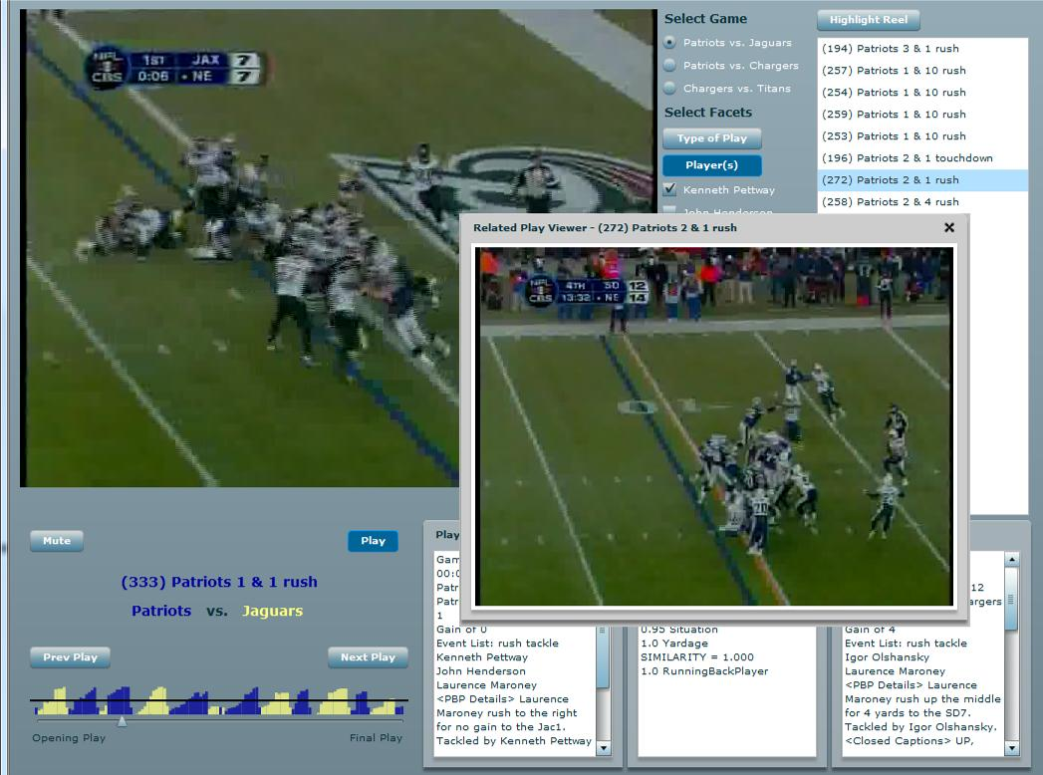
Football Prototype
Notes:
a bar graph is used to indicate the field position, and color is used to represent which team possesses the football. This enables a user to jump specifically to portions of the game for a given team's offensive drive. Equally important, with a glance, a user gains an understanding of the duration and depth of each offensive drive. Sudden changes in possession give the user a clue to turnovers, while dips in field position give indications of setbacks such as sacks or penalties. Such visualizations enable powerful exploratory search processes, an important counterpart to the directed search enabled by a facet filtered list.
Designed for experts

Slide 60
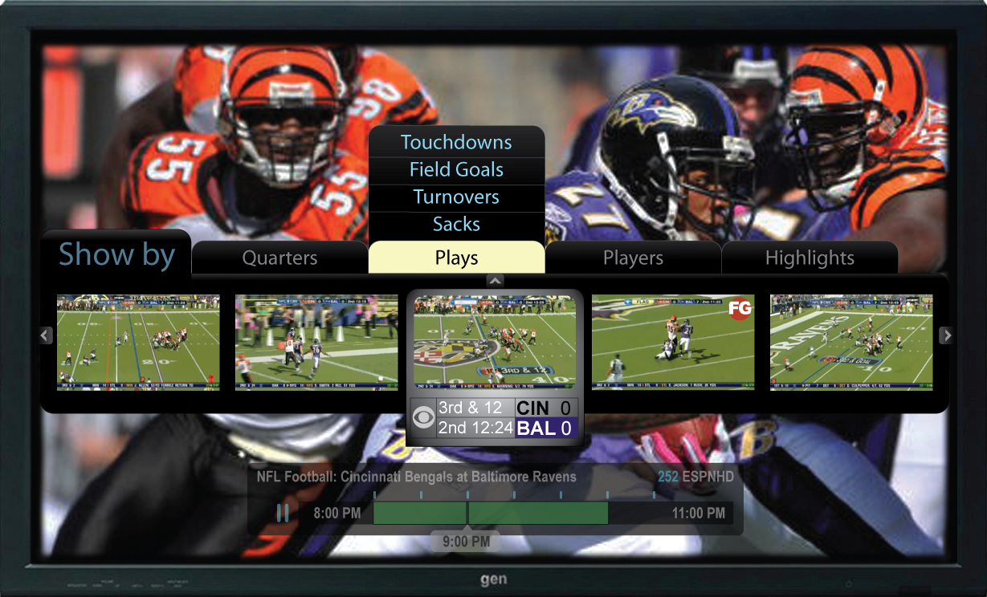
Application – Football Prototype

Slide 61
Experiments and Evaluation

Slide 62
Evaluation metrics
How well does the hypothesized set of boundaries match the true (reference) set?
P_{k} (Beeferman, et al. 1997) and WindowDiff (Pevzner & Hearst, 2002)
Both compare hypothesis to reference segmentation within a sliding window
P_{k} is the proportion of windows in which hypothesis and reference disagree on the number of boundaries
WindowDiff tallies the difference in the number of boundaries in each window
Both commonly used instead of precision and recall, because they take approximate matching into account
They have drawbacks of their own, however
Doug Beeferman, Adam Berger, and John Lafferty. 1997. Text Segmentation Using Exponential Models. Proceedings of EMNLP 2
Lev Pevzner and Marti A. Hearst. 2002. A critique and improvement of an evaluation metric for text segmentation. Computational Linguistics, 28:1
Notes:
We report precision and recall numbers but these are not ideal. Coz missing a boundary by one sentence is penalized same as missing a boundary by 10 sentences.
So we also report results with 2 metrics commonly employed in segmentation work – Pk & Wdiff.

Slide 63
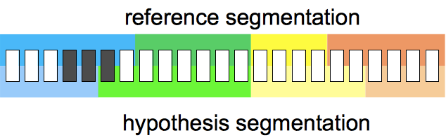
Evaluation metrics: P_{k} and WindowDiff
Take a sliding window (half the average reference segment size)
One black mark against the hypothesis segmentation, where it differs from the reference (mistakes closer to reference boundaries appear in fewer windows, and are thus penalized less)
Notes:
Pk: At each step, look through the window and check if each of the two segmentations say the ends of the window are in the same segment If they disagree, it counts as an error WindowDiff: everything is the same, except you ask how many boundaries fall within the window

Slide 64
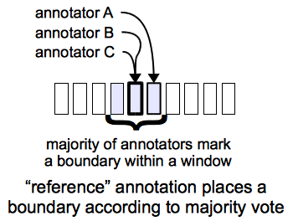
Results on TV shows
Data: Closed captions for 13 tv shows (News, talk shows, documentaries, lifestyle shows)
5 annotators manually marked up major and minor boundaries, using 1-5 rating scale
As expected, IAA is low, so we create a reference annotation
Notes:
Just to show how difficult the topic segmentation task on tv shows is, we did some experiments for inter annotator agreement.

Slide 65
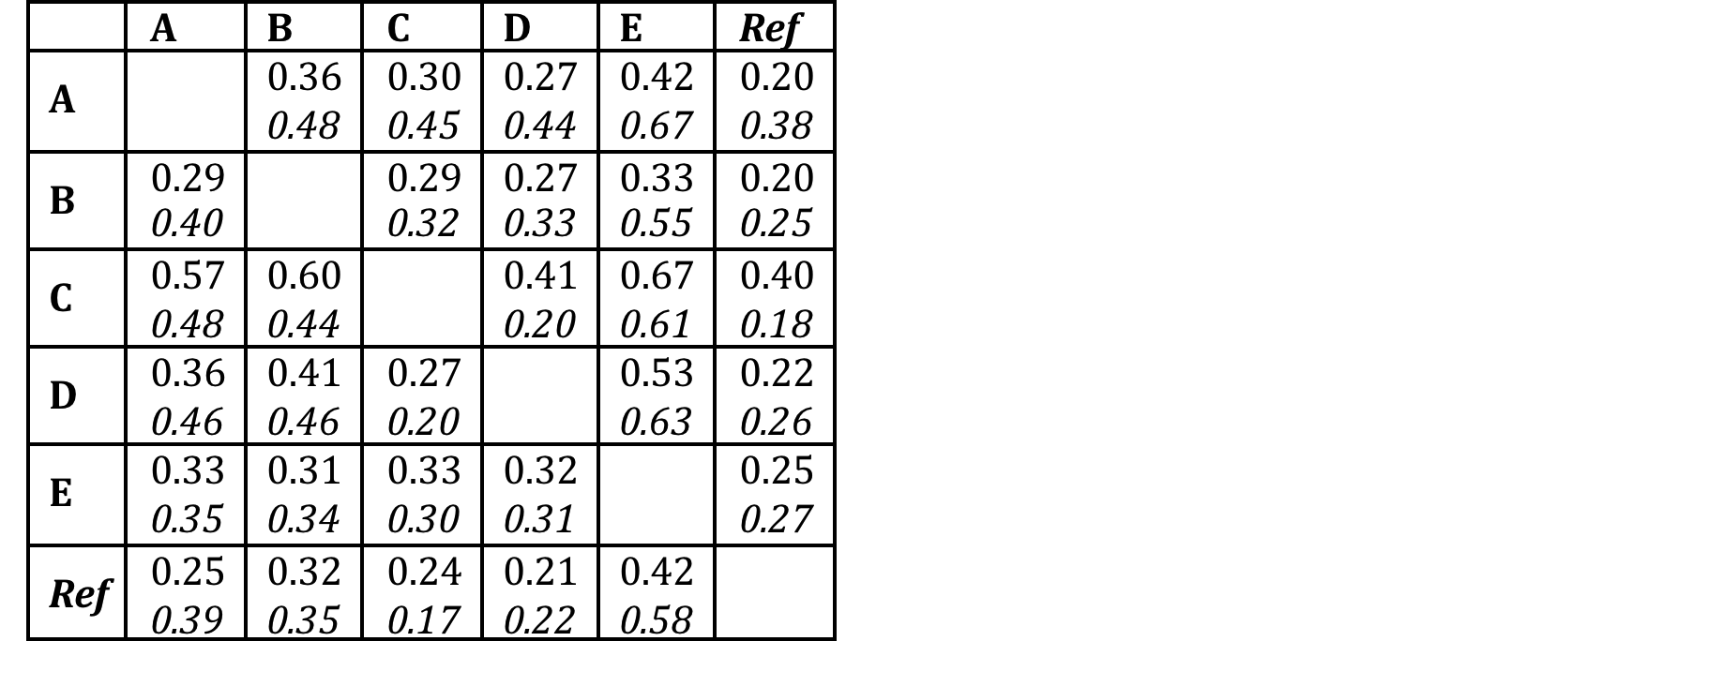
TV show closed-captions: inter-annotator agreement on segmentation
Pk values between pairs of annotators: all boundaries and major boundaries
Note that matrix is asymmetrical
Notes:
You will see that the disagreement is pretty high for this task.

Slide 66
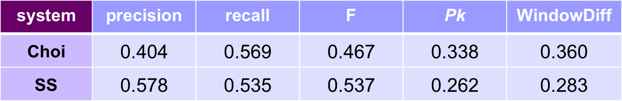
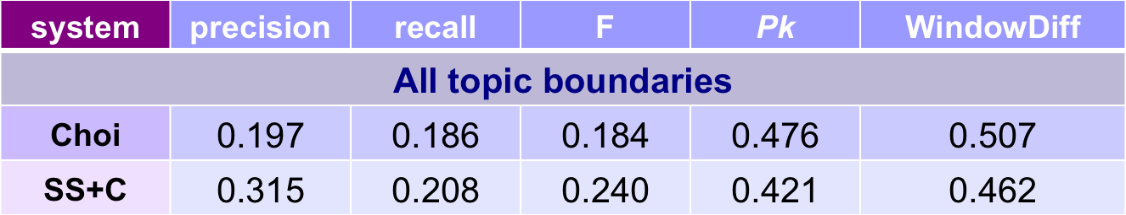
Results for Text Segmentation (Graphy)
Pseudo-Document Set
185 documents each containing 20 Concatenated New York Times articles
Number of boundaries not specified to systems
TV Show closed captions
Notes:
Results we got are about .4 so we have some still ways to go to reach human annotator disagreement levels but seems promising.

Slide 67
What did we learn?
Initial findings
Graphs constructed from RIs do seem to help segmentation
Semantic relatedness with reinforcement from neighboring terms
Works decently on “noisy” material, such as TV shows
Doesn't’t require any training; however, there are lots of parameters to play with (and we have started exploring training to optimize them)
Yet to be done
Try community detection to segment a graph, or learn boundary detection through various graph features
Try to use the graphs for more complex segmentation tasks, such as hierarchical segmentation; community structure in a graph might reflect hierarchical organization of discourse
Try to find the most “central” terms in a subgraph, to use as segment labels

Slide 68
Evaluation Metrics: A User Perspective
Clips can start or end too early, Harder than it looks
4 Error types
Clips Starts too Late (Really Bad!)
Clip Ends too Early (Really Bad!)
Clip Starts too Early
Clip Ends too Late
Methodology: We align the reference and hypothesis alignment and compute all 4 error percentages based on a tolerance threshold
Ignore Teasers, intro etc.
Duplicate Detection
Add Buffering
Minimum Clip Length
Notes:
Now in our real world system, we also evaluated from the user perspective.
What the user sees is clips so we came up with these errors we measure where type 1 & 2 are the most egregious.

Slide 69
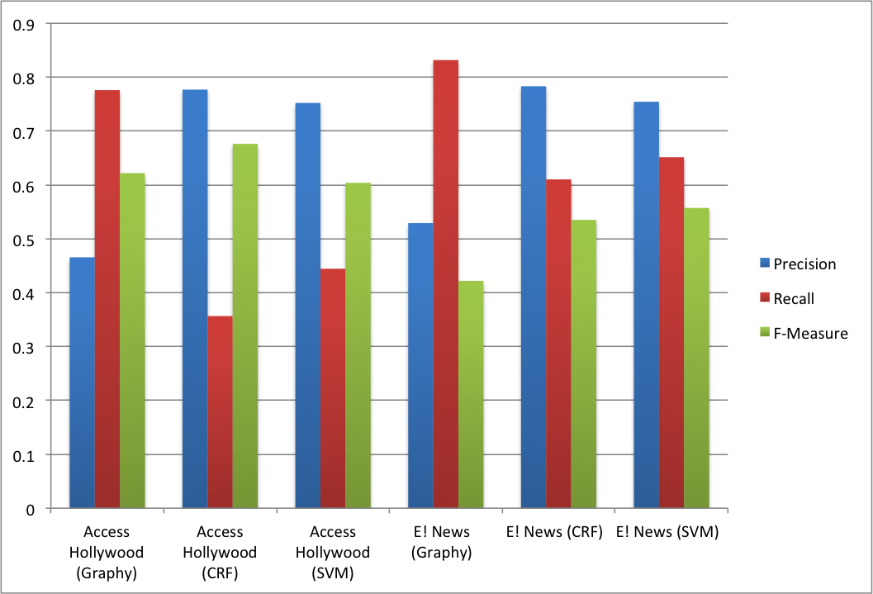
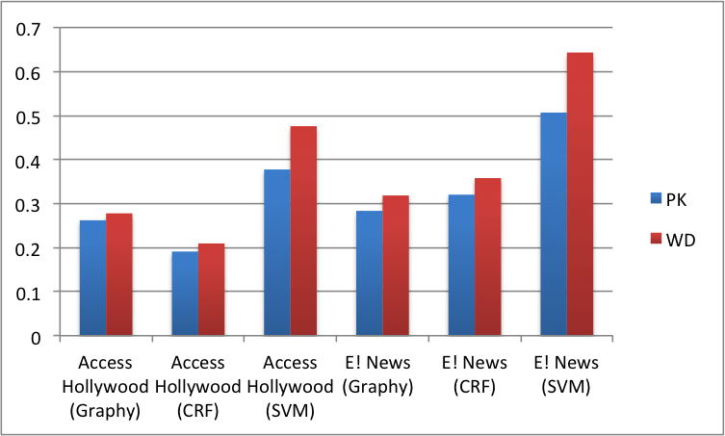
Segmentation Results
Entertainment News (E! News versus Access Hollywood)
Notes:
We see that for both programs, the crf & svms do better than graphy alone. Which is as we expect.
However, the pk, window diff differ

Slide 70
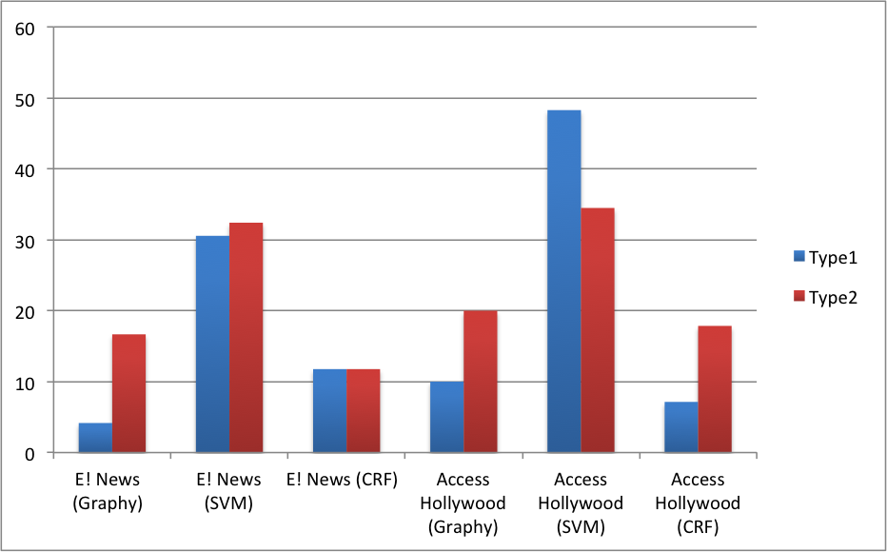
Segmentation Results
Entertainment News (E! News versus Access Hollywood)
Notes:
Now here you see the difference between the errors calculated on matching sentences versus those on matching times.
We have a tolerance here of 3 seconds
Now here crfs do ok but graphy seems to do even better.
Just goes to show you how much the evaluation of the task varies.

Slide 71
Conclusions
Notes:
3rd pilot

Slide 72
Future Work
Semi Supervised Approach
Limited Annotation Data, Lots of Unlabeled Data
Multi-Stage Classifier
Learn Program Hierarchy
Ex: Bill Maher – [Monologue, Panel, Guest, New Rules]
Rachel Maddow: [Intro, Segment, Segment …., Moment of Geek]
Second stage classifier to segment the topical parts.

Slide 73
Conclusion
Video Segmentation is technically challenging
Different Varieties of Content require different approaches
Individual domains and even programs have their own quirks – no one approach fits all types
Good features beat clever techniques
What we optimize for and what the user wants are different !
Holy Grail:
Compelling applications that can work for both the content producer & content distributor/aggregators
Impact how we search, browse, navigate and interact with video.
Will The Television Be Revolutionized ???

Slide 74
Questions/Suggestions ?

Slide 75
Extras

Slide 76
Graphy
Feature Compute
Count the number of new RI being introduced at each sentence (FRI)
Smooth the counts by a sliding window moving forward
Count the number of RI ending at each sentence (BRI)
Smooth the counts by a sliding window moving Backward
Compute the Harmonic Mean of FRI and BRI as the probability of having a boundary at each sentence

Slide 77
Low Level Visual Features
Black frame detection
Usually found at commercial break boundaries
Video Frame Entropy
Captures the entropy using the red, green, blue features in a frame. High entropy indicates content rich frames, while low entropy usually indicates black frame, pure color frame, or frame that contains sharp contrast text
Pairwise Joint Entropy
Pairwise joint entropy and the matrix of joint entropy for the red, green, blue, hue, saturation and value
Pairwise Kullback–Leibler (KL) Divergence
KL Divergence matrix for red, green, blue, hue, saturation and value
Cut Rate Analysis
Uses 15 bins HSV feature vector and adhoc Mahalanobis distance.

Slide 78
Systems compared
Choi | Implementation from MorphAdorner*
SN | Our system, using a single node for each term occurrence (no extension)
FE | Our system, using an extension of a fixed number of sentences for each term from the sentence it occurs in
SS | Our system, using Ris without “hard” boundaries determined by the modified Choi algorithm
SS+C | Our full segmentation system, incorporating “hard” boundaries determined by the modified Choi algorithm
* morphadorner.northwestern.edu/morphadorner/-textsegmenter
Notes:
Now that we have talked about the metrics, lets talk about the systems we have to compare.
Now first I am going to talk bout our text based algorithm (graphy)
We consider a system where we don’t model a terms influence at all. So no ris
Next we consider a system where a terms influence is represented by a fixed length extension. (10 sentences)
Last 2 versions use the RIs I described earlier.
These comparisons aim to demonstrate first, the usefulness of modeling a zone of influence for terms beyond the sentence they occur in, and second, the effectiveness of RIs in modeling that influence accurately.
Lastly, to establish how much we can gain from using Choi’s algorithm to determine termination points for RIs, we also compared two versions of our system: one in which RIs are calculated without information from Choi’s algorithm and a second with these boundaries included.

Slide 79
Results on pseudodocuments
185 documents each containing 20 Concatenated New York Times articles
Number of boundaries not specified to systems
system | precision | recall | F | Pk | WindowDiff
Choi | 0.404 | 0.569 | 0.467 | 0.338 | 0.360
SN | 0.096 | 0.112 | 0.099 | 0.570 | 0.702
FE | 0.265 | 0.140 | 0.176 | 0.478 | 0.536
SS | 0.566 | 0.383 | 0.448 | 0.292 | 0.317
SS+C | 0.578 | 0.535 | 0.537 | 0.262 | 0.283

Slide 80
TV show closed-captions: segmentation
Accuracy is low, which is unsurprising given the low IAA
system | precision | recall | F | Pk | WindowDiff
All topic boundaries
Choi | 0.197 | 0.186 | 0.184 | 0.476 | 0.507
SS+C | 0.315 | 0.208 | 0.240 | 0.421 | 0.462
Major topic boundaries only
Choi | 0.170 | 0.296 | 0.201 | 0.637 | 0.812
SS+C | 0.271 | 0.316 | 0.271 | 0.463 | 0.621
Notes:
Results we got are about .4 so we have some still ways to go to reach human annotator disagreement levels but seems promising.

